Slide 1
Regular Graphs
Youtube.com/StatsLabDublin
Discrete Mathematics

Slide 2
Regular Graphs
In an n-regular graph, the vertices are all of degree n.

Slide 3
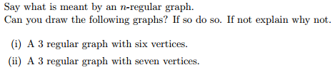
Regular Graphs

Slide 4
Regular Graphs

Slide 5
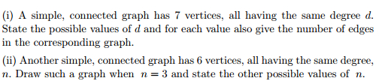
Regular Graphs

Slide 6
Regular Graphs

Slide 7
Regular Graphs

Slide 8
Regular Graphs

Slide 9
Regular Graphs

Slide 10
Regular Graphs

Slide 11
Regular Graphs

